Slide 1
Data flow diagram (DFD)
DhirajShrestha
Lecturer
Department of Computer Science and Engineering

Slide 2
Dataflow Diagram (DFD)
Definition:
It is a process model used to depict the flow of data through a system and the work or processing performed by the system. Synonyms are bubble chart, transformation graph, and process model.
It is also called process models.
The DFD has also become a popular tool for business process redesign

Slide 3
Differences Between DFDs and Flowcharts
Processes on DFDs can operate in parallel (at-the-same-time)
Processes on flowcharts execute one at a time
DFDs show the flow of data through a system
Flowcharts show the flow of control (sequence and transfer of control)
Processes on a DFD can have dramatically different timing (daily, weekly, on demand)
Processes on flowcharts are part of a single program with consistent timing

Slide 4
Why DFD
Provides an overview of
What data a system processes
What transformations are performed
What data are stored
What results are produced and where they flow
Graphical nature makes it a good communication tool between
-User and analyst
-Analyst and System designer
Structure of DFD allows starting from a broad overview and expand it to a hierarchy of detailed diagrams

Slide 5


External agent
External agent – an outside person, unit, system, or organization that interacts with a system. Also called an external entity.
External agents define the “boundary” or scope of a system being modeled.
As scope changes, external agents can become processes, and vice versa.
Almost always one of the following:
Office, department, division.
An external organization or agency.
Another business or another information system.
One of system’s end-users or managers
Named with descriptive, singular noun
Gane and Sarson shape
DeMarco/Yourdon shape

Slide 6


Data stores
Data store – stored data intended for later use. Synonyms are file and database.
Frequently implemented as a file or database.
A data store is “data at rest” compared to a data flow that is “data in motion.”
Almost always one of the following:
Persons (or groups of persons)
Places
Objects
Events (about which data is captured)
Concepts (about which data is important)
Data stores depicted on a DFD store all instances of data entities (depicted on an ERD)
Named with plural noun
Gane and Sarson shape
DeMarco/Yourdon shape

Slide 7
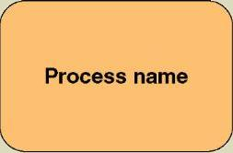
Process Concepts
Process – work performed by a system in response to incoming data flows or conditions. A synonym is transform.
All information systems include processes - usually many of them
Processes respond to business events and conditions and transform data into useful information
Modeling processes helps us to understand the interactions with the system's environment, other systems, and other processes.
Named with a strong action verb followed by object clause describing what the work is performed on/for .
Gane and Sarson shape

Slide 8
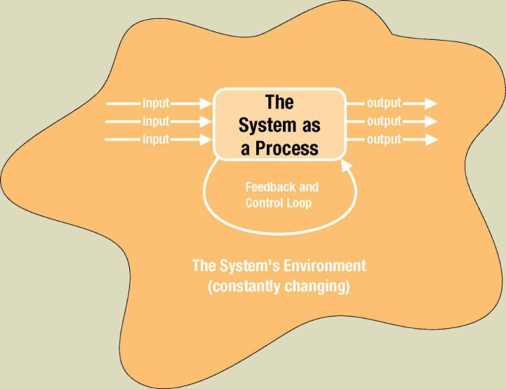
The System is Itself a Process

Slide 9
Flows of data in the system can take place :
Between 2 processes
From a data store to a process.
From a process to data store
From a source to a process; and
From a process to a sink

Slide 10
Good Style in drawing DFD
Use meaningful names for data flows, processes and data stores.
Use top down development starting from context diagram and successively leveling DFD
Data stores cannot create new data.
Only previously stored data can be read.
A process can only transfer input to output. It cannot create new data.

Slide 11
Describing a System with DFD
An entire system is represented by one DFD which gives the system’s overview.
It is called a context diagram.
It gives little detail & is also known as the top level DFD

Slide 12
Context data flow diagram
Context data flow diagram - a process model used to document the scope for a system. Also called the environmental model.
Think of the system as a "black box."
Ask users what business transactions the system must respond to. These are inputs, and the sources are external agents.
Ask users what responses must be produced by the system. These are outputs, and the destinations are external agents.
Identify any external data stores, if any.
Draw a context diagram

Slide 13
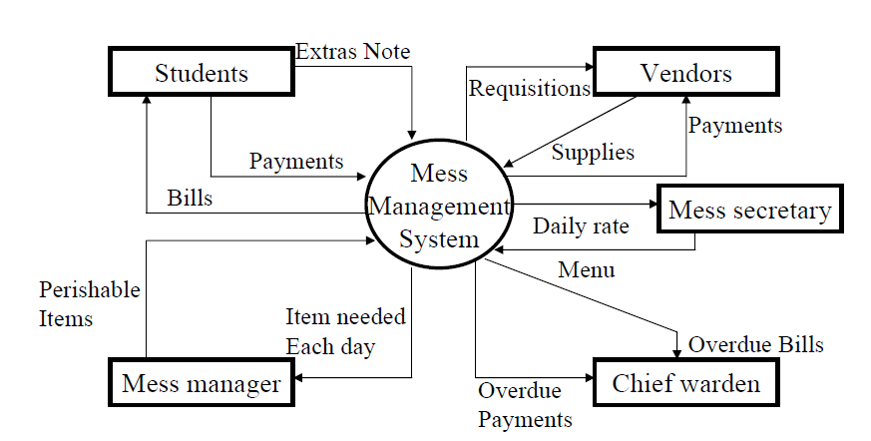
Describing a System with DFD

Slide 14
Leveling DFD
A context diagram gives an overview
It should be split into major processes which give greater detail.
Each major process is further split to give more detail.

Slide 15
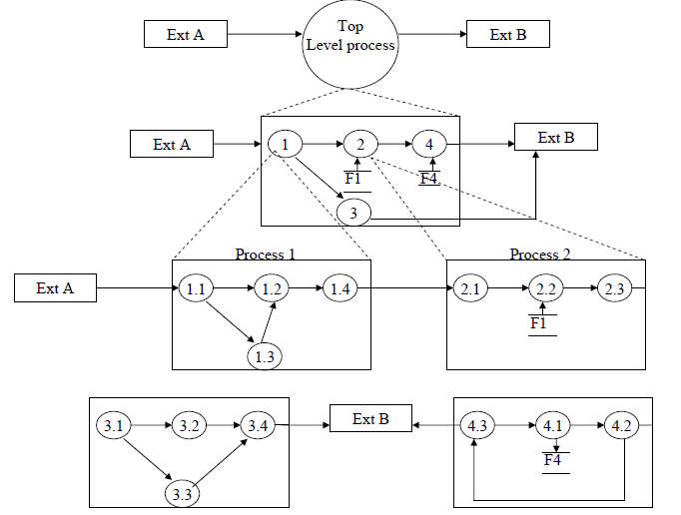
Leveling DFD

Slide 16
Why Level DFD
If a DFD is too detailed it will have too many data flows and will be large and difficult to understand.
Start from a broad overview. Expand to details -Idea similar to using procedures and linking these with a main program.
Each DFD must deal with one aspect of a big system

Slide 17
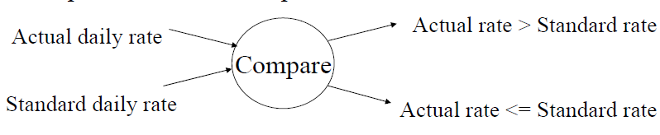
Illegal Constructs in DFD
No loops are allowed in DFD
A process cannot be a pure decision

Slide 18
Illegal Constructs in DFD
A single data flow should not be split into many flows with different labels.
No data flow allowed between data stores.

Slide 19
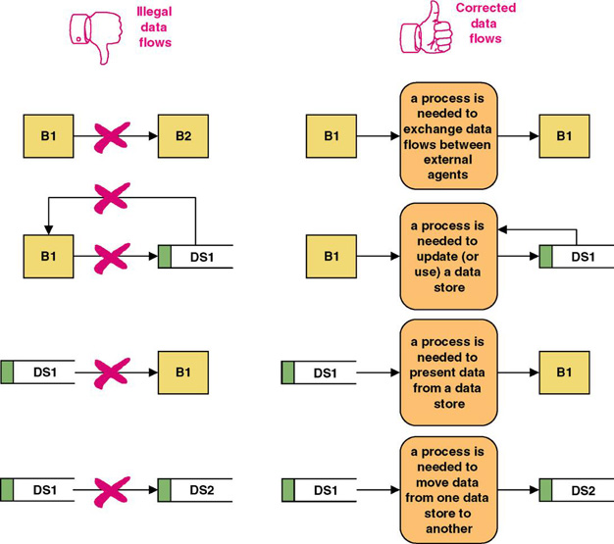
Rules for Data Flows
A data flow should never go unnamed.
In logical modeling, data flow names should describe the data flow without describing the implementation
All data flows must begin and/or end at a process.

Slide 20
Logical and Physical DFD
DFD’S considered so far are called logical DFDs
Physical DFD may depict physical movements of the goods
A physical DFD is similar to a document flow diagram.
It specifies who does the operations specified by the logical DFD
A Physical DFDs can be drawn during fact gathering phase of a life cycle.

Slide 21
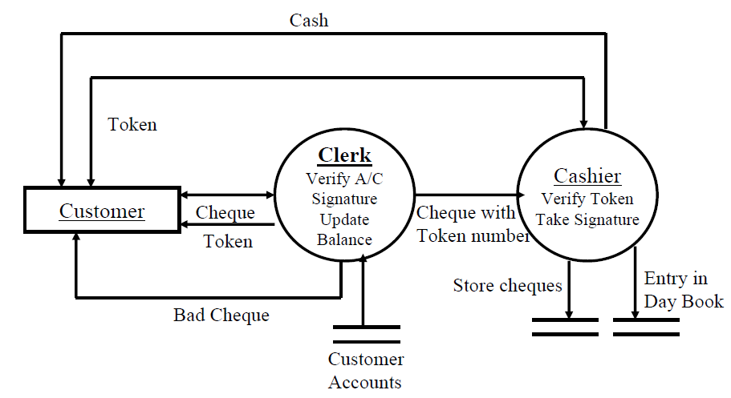
Physical DFD

Slide 22
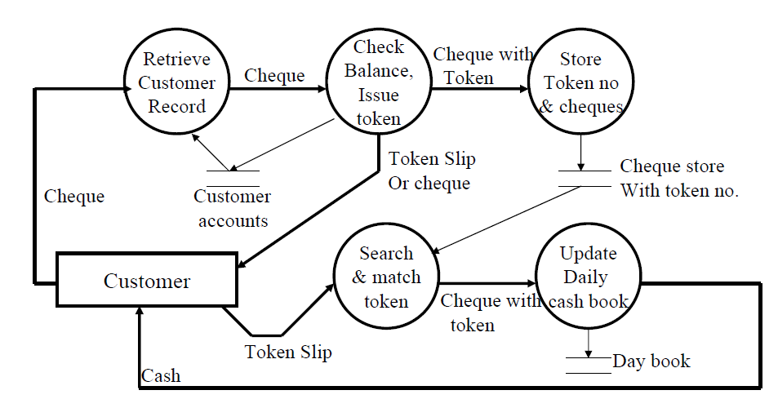
Logical DFD

Slide 23
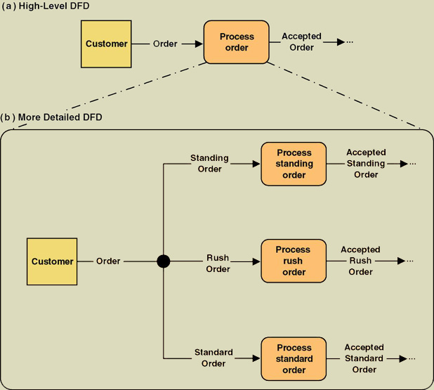
Composite and Elementary Data Flows
Composite flow
Elementary flows
Junction indicates that any given order is an instance of only one of the order types.

